Slide 1
Cultural Food Video Presentation
NUTR 301-1001
Shakariyah Jimerson
12-5-2019

Slide 2
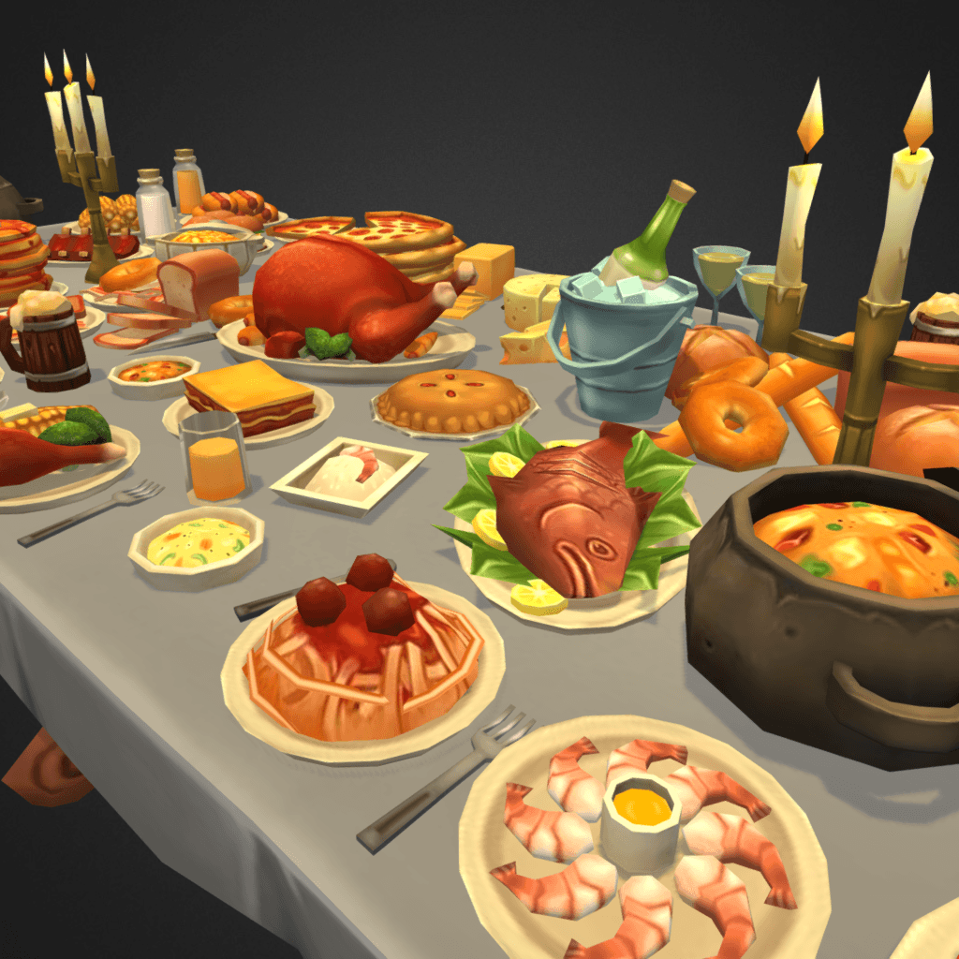
Traditional food
The traditional food that we are going to make is Melt-in-Your-Mouth Chuck Roast.
These are some of the favorite foods in America that are loved by many people.
It takes some time for it to get ready during preparation.
The ingredients above are the ones we shall use to prepare our traditional chuck roast.
This food will melt on your mount during consumption. The procedures below give the process of making our food that we are going to make.

Slide 3
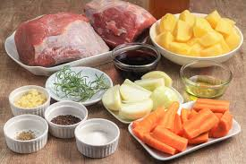
Melt-in-Your-Mouth Chuck Roast Recipe
Ingredients
One can of stewed tomatoes Italian, undrained
Beef broth half a cup
Red crushed pepper flakes a quarter teaspoon
One onion, sliced and halved
Chopped celery rib only one
Sugar 3 tablespoons

Slide 4
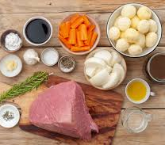
A quarter cup of cold water
Cornstarch three tablespoons
A boneless roast chuck beef
One tablespoon sauce soy
Minced, three garlic cloves
Halved and sliced medium green pepper
Four teaspoons Mustard prepared
Sauce Worcestershire two tablespoons

Slide 5
Procedure of preparation
Make a mixture of the first ten ingredients. Put celery in a 5- qt, onion, and pepper, which is green. Put a roast on top of a slow cooker. Add a mixture of tomato on the roast. Continue cooking and cover and maintain on low up to meat becomes tender; the preparation method should be about 6 hours.
Take off the roast — vegetables used for reserving, strain cooking juice. Take juices to a saucepan; remove fat. Make a mixture of water and cornstarch till it is smooth; mix in the cooking juices. Ensure it comes to boil; stir as you continue cooking for like 2 minutes. Serve gravy together with vegetables and roast.
Option to freeze: put vegetables and chopped beef into freezer containers; add gravy to top. Fresh then take to freeze. Thaw partially into a refrigerator throughout the night pass heat when covered in saucepan slowly, while you stir gradually and add water or little broth.

Slide 6

Kitchen Tips
Brown, dark sugar has a lot of molasses compared to brown, golden sugar. In recipes, these types are interchangeable in general. In case someone loves the bolder flavor, the person is advised to use brown, dark sugar.
At first sauce, Worcestershire was not suitable for use. It could end been pungent batch in his cellular. It had a strange taste.

Slide 7
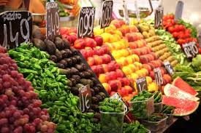
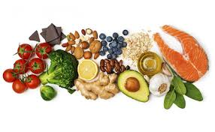

Facts about Nutrition
Cooked 5 ounces beef with a quarter cup gravy: 364 calories, 100gms cholesterol, 20h fat, 850mg sodium, 30 protein, and 25 carbohydrates.

Slide 8
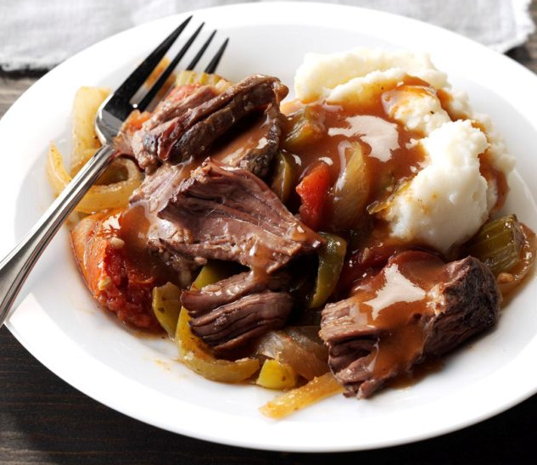
The picture below is the traditional food we have prepared, which is Melt-in-Your-Mouth Chuck Roast.

Slide 9
Reference
DeRosa, G. P. (2019). What's Important: Stopping to Taste the Candy. JBJS, 101(1), 95-96.
Horn, T. R. (2018). Cooking with Rocks the Hopewell Way: Experimenting with Earth Oven Efficiency. The Proceedings of GREAT Day, 16, 26.

